Slide 1
Hill Cipher

Slide 2
Introduction
Multi-letter substitution cipher (block cipher) based on Linear algebra
Invented by Lester S.Hill during 1929
Basic knowledge of matrix multiplication, inverse matrix multiplication and modulo calculation is needed

Slide 3
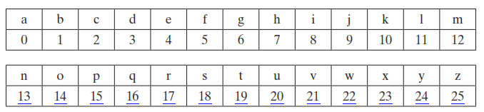
Assigning numbers to letters

Slide 4

Encryption and Decryption

Slide 5
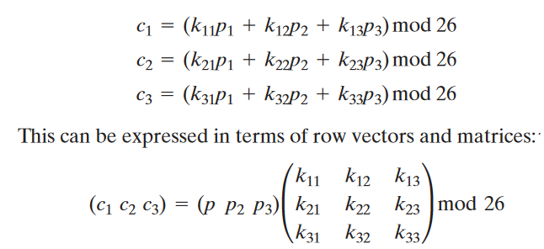
Encryption
E(K, P) = (K * P) mod 26
K – key matrix, P – plain text

Slide 6
Encryption
Turn the keyword to matrix
Split the plaintext into trigraphs
Matrix multiplication
Modulus of column vectors
2
1
Plaintext = paymoremoney
= pay mor emo ney
K = 17 17 5
21 18 21
2 2 19

Slide 7
Matrix multiplication
Modulus of column vectors
4
3
4
( 15 0 24) x ( 17 17 5 ) = ( 303 ) mod 26 = ( 17 )
21 18 21 303 17
2 2 19 531 11
4
4
(17 17 11) = R R L

Slide 8
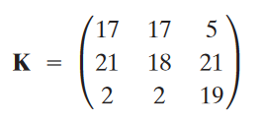
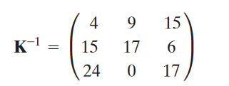
Decryption
P = D(K,C) = CK⁻¹ mod 26
(17 17 11) ( 4 9 15) ( 587 )
15 17 6 = 442 mod 26 = ( 15 0 24 ) = ( p a y )
24 0 17 544

Slide 9
Hill cipher
Aim: To implement hill cipher using java
Algorithm:
Input plain text (P) and key (K)
Form the key in 3x3 matrix format
Divide the given input plain text into trigraphs
Perform K x P mod 26 for every trigraphs
The resultant trigraphs show the cipher text C
Find K⁻¹ of the given matrix K
Form trigraphs for C
Perform C x K⁻¹ mod 26 to determine the plain text
The resultant trigraphs show the plain text P
Display the plaintext and ciphertext

Slide 10
class hillCipher
{
public static int[][] keymat = new int[][] { { 17, 17, 5}, { 21, 18, 21 }, { 2, 2, 19 } };
public static int[][] invkeymat = new int[][] { { 4, 9, 15}, { 15, 17, 6 }, { 24, 0, 17} };
public static String key = "ABCDEFGHIJKLMNOPQRSTUVWXYZ";
private static String encode(char a, char b, char c)
{
String ret = "";
int x, y, z;
int posa = (int) a - 65;
int posb = (int) b - 65;
int posc = (int) c - 65;
x = posa * keymat[0][0] + posb * keymat[1][0] + posc * keymat[2][0];
y = posa * keymat[0][1] + posb * keymat[1][1] + posc * keymat[2][1];
z = posa * keymat[0][2] + posb * keymat[1][2] + posc * keymat[2][2];
a = key.charAt(x % 26);
b = key.charAt(y % 26);
c = key.charAt(z % 26);
ret = "" + a + b + c;
return ret;
}

Slide 11
private static String decode(char a, char b, char c)
{
String ret = "";
int x, y, z;
int posa = (int) a - 65;
int posb = (int) b - 65;
int posc = (int) c - 65;
x = posa * invkeymat[0][0] + posb * invkeymat[1][0] + posc * invkeymat[2][0];
y = posa * invkeymat[0][1] + posb * invkeymat[1][1] + posc * invkeymat[2][1];
z = posa * invkeymat[0][2] + posb * invkeymat[1][2] + posc * invkeymat[2][2];
a = key.charAt((x % 26 < 0) ? (26 + x % 26) : (x % 26));
b = key.charAt((y % 26 < 0) ? (26 + y % 26) : (y % 26));
c = key.charAt((z % 26 < 0) ? (26 + z % 26) : (z % 26));
ret = "" + a + b + c;
return ret;
}

Slide 12
public static void main(String[] args) throws java.lang.Exception
{
String msg;
String enc = "";
String dec = "";
int n;
msg = (“paymoremoney");
System.out.println("simulation of Hill Cipher\n-------------------------");
System.out.println("Input message : " + msg);
msg = msg.toUpperCase();
msg = msg.replaceAll("\\s", "");
n = msg.length() % 3;
if (n != 0)
{
for (int i = 1; i <= (3 - n); i++)
{
msg += 'X';
}
}

Slide 13
System.out.println("padded message : " + msg);
char[] pdchars = msg.toCharArray();
for (int i = 0; i < msg.length(); i += 3)
{
enc += encode(pdchars[i], pdchars[i + 1], pdchars[i + 2]);
}
System.out.println("encoded message : " + enc);
char[] dechars = enc.toCharArray();
for (int i = 0; i < enc.length(); i += 3)
{
dec += decode(dechars[i], dechars[i + 1], dechars[i + 2]);
}
System.out.println("decoded message : " + dec);
}
}

Slide 14
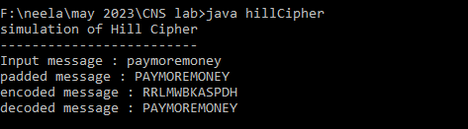
Output

